Slide 1
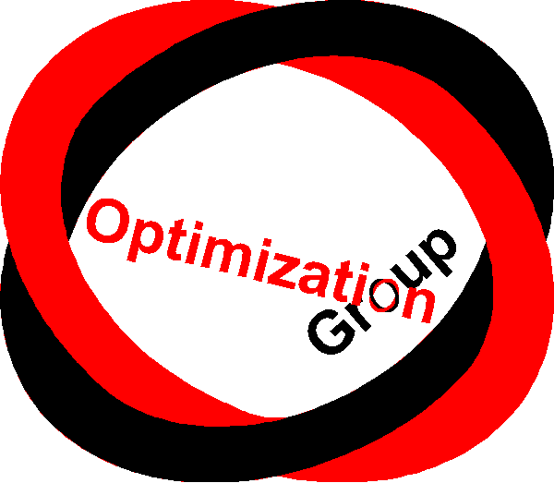

TIES483 Nonlinear Optimization Decision-making under Uncertainty (part 2) spring 2022
Babooshka Shavazipour, PhD
Babooshka.b.shavazipour@jyu.fi

Slide 2
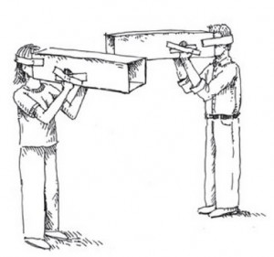
Dealing with uncertainty in practice
➢ In practice, for complex problems (e.g., strategic planning) uncertainties are incompletely understood and potential outcomes not enumerable
➢ Probabilities and derived concepts (Expectation, Variance) are not properly deﬁned
The point.
In some real problems, probability and statistics are not suﬃcient to represent our entire knowledge and, therefore, some supplementary tools should be used in addition to probabilistic methods.
Under such circumstances, a decision
Needs to relatively seize our objective(s), and
To be robust (i.e., perform satisfactorily under a broad variety of futures)

Slide 3


How can we deal with uncertainty? General approaches
The predict and act approaches:
a. Assume the future is knowable
b. Assume the future will (probabilistically)
look like the past
Robust approches (consider future variabilities):

Slide 4
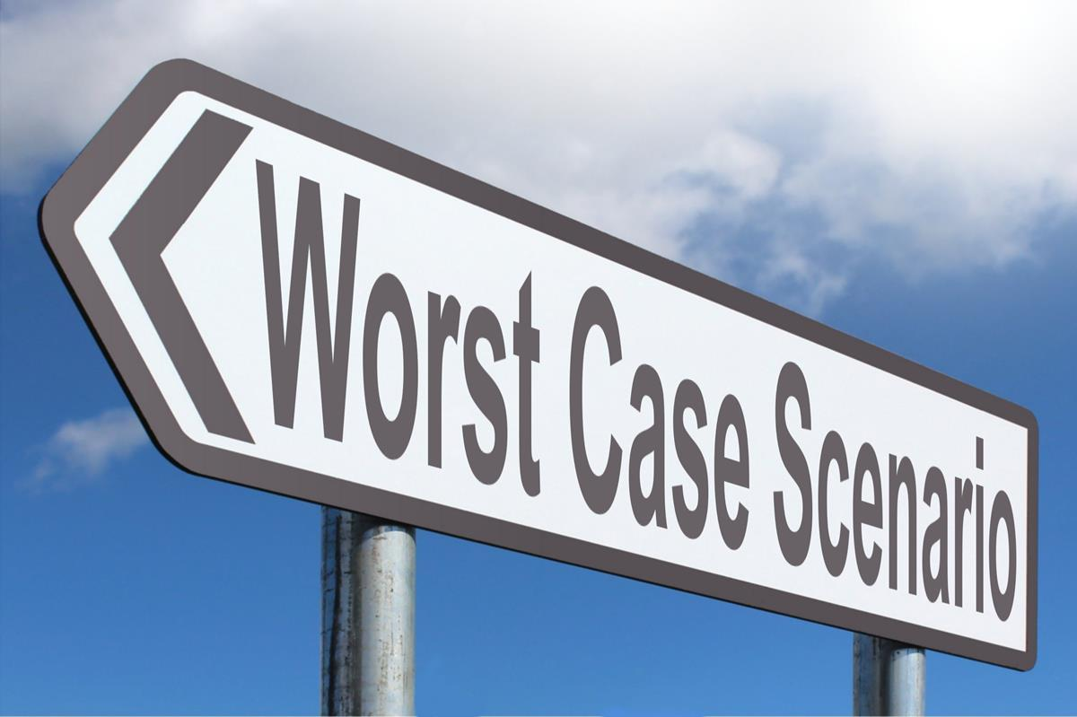

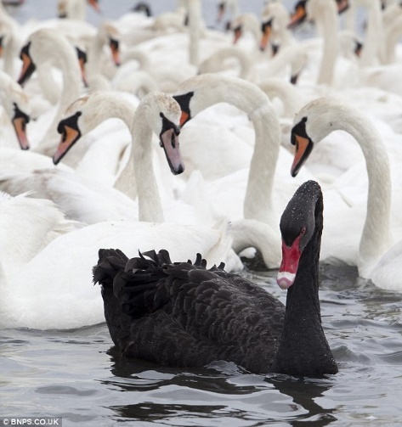
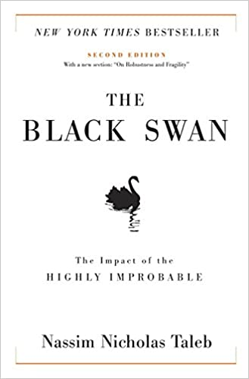
Robust approaches:
2.1. Resistance (Min-Max robustness):
Plan for the worst-case scenario in the future.
Bad news: it is signiﬁcantly costly
But what would be the worst case then?
From which perspective?
The worst-case or several worst cases?
Worst news: the plan may not work well because of Surprises or Black Swans (Painful events).
Worst case
case
Worst case
Worst case
Worst case
Worst case
Worst case
Worst case

Slide 5
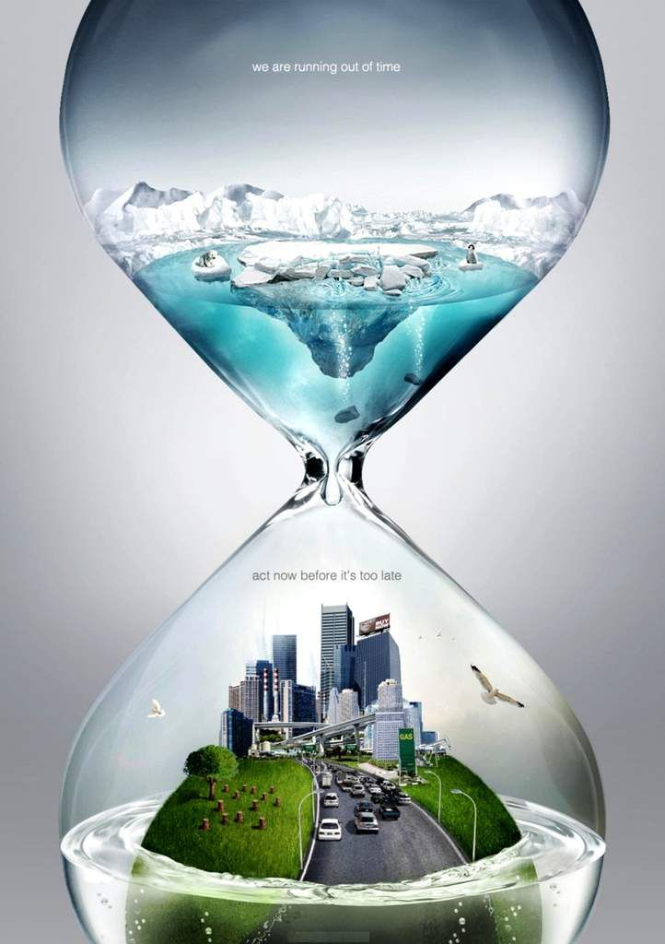
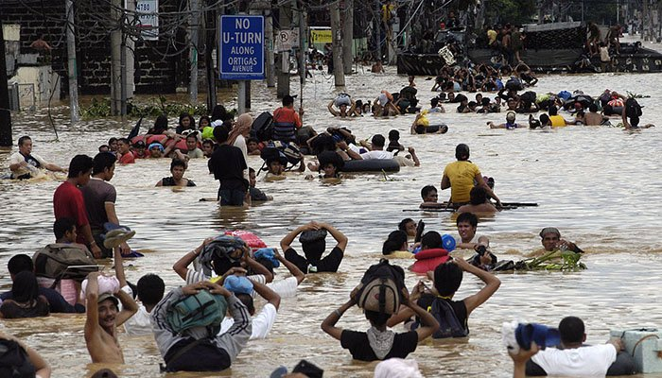
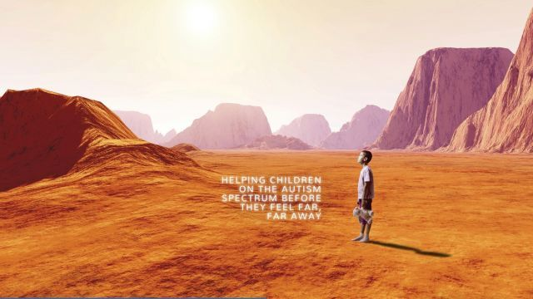
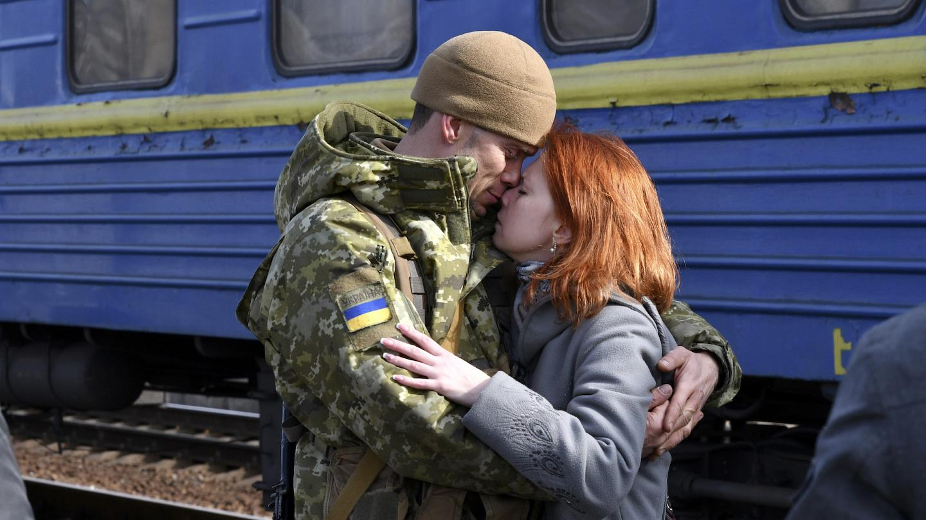
Robust approaches:
2.2. Resilience: Concentrate on recovering the system, but,
without considering plausible future events.
Accepts short-term pain and negative system performance but focuses on recovery, whenever, a different scenario has happened.
It might be too late then!
(Good Luck ! God will help you!)

Slide 6

Robust approaches:
2.3. Static robustness (considering different futures):
Look for a decision/policy that will do well in a few scenarios
Decrease vulnerability in the widest possible range of diﬀerent futures
But is it enough?
What if the experts do not know and/or can not agree on what the future might bring? Specially in long-term planning.
The world is continuously changing!

Slide 7
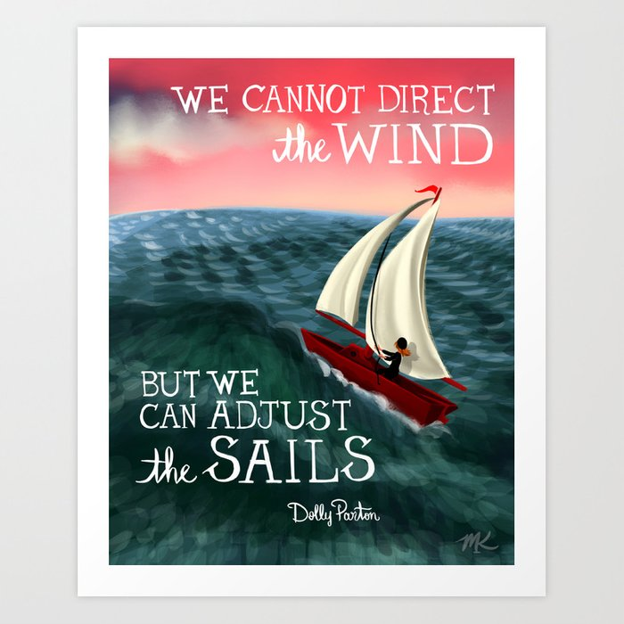
Robust approaches:
2.4. The monitor and adapt (dynamic robustness) approach:
Assume the future cannot be predicted and implement dynamic adaptive policies.
Plan for continuous change and adaptation regarding upcoming situations
Basic principles:
Indeed, we do not produce forecasts
Instead, we seek robust decisions that perform well in many different realizations of the future (not an optimal in one scenario)
Explore the vulnerabilities/fragilities of the decisions and identify the adaptation/contingency plans
Monitor the progress and update/adapt whenever is needed

Slide 8
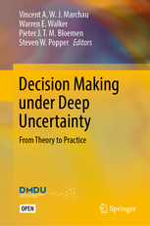
Decision Making under Deep Uncertainty (DMDU)
DMDU methods aim to support decision-makers to find the robust, adaptive decisions
Exploratory Modeling* approaches (e.g., Scenario Discovery) to identify vulnerabilities
Robust Decision Making (RDM)** is an iterative analytic process to testing alternatives robustness
Dynamic Adaptive Policy Pathways¤ support DMs to identify, compare and choose adaptations and contingency plans for multiple scenarios
…
Open Access book: https://link.springer.com/book/10.1007/978-3-030-05252-2
DMDU society https://www.deepuncertainty.org/
* S. Bankes, W..E. Walker, and J.H. Kwakkel (2013). “Exploratory Modeling and Analysis”, entry (pp. 532-537) in S. Gass, and M..Fu (eds.), Encyclopedia of Operations Research and Management Science., 3rd Edition, New York: Springer.
$$^{∗∗} Lempert et al. \left(2006\right), ‘A general, analytic method for generating robust strategies and narrative scenarios’,Management Science 52(4), 514–528.$$
¤ M. Haasnoot, J.H. Kwakkel, and W.E. Walker (2013). “Dynamic Adaptive Policy Pathways: A New Method for Crafting Robust Decisions for a Deeply Uncertain World”, Global Environmental Change, Vol. 23, No. 2, pp. 485–498.

Slide 9
Decision-making under deep uncertainty (DMDU)
Triditional MORDM techniques
Consider one nominal/reference scenario
Use Evolutionary algorithms to generate solutions for the single-scenario MOOP
Randomly generate a wide range of plausible scenarios (1000-10’000)
Re-evaluate the solutions in all random scenarios
Select solutions which provide better performances in a wider range of scenarios (robust)
More recently, these methods integrated by robust multiobjective optimization methods from mathematical programming literature (see, e.g., https://www.sciencedirect.com/science/article/pii/S1364815221001778 )
Open Access book: https://link.springer.com/book/10.1007/978-3-030-05252-2

Slide 10
Robustness in (mathematical) optimization problems
Robust optimisation (RO) is one of the more recent approaches to treat uncertainty in optimisation problems.
However, its origin goes back to the use of worst-case analysis to deal with uncertainty in the foundation of the modern decision theory in the 1950s.
RO, generally, help DMs in dealing with two diﬀerent types of uncertainty:
The uncertainty of feasibility (i.e. the feasibility of a solution is aﬀected by uncertainty), or
The uncertainty of optimality (i.e. the optimality of a solution is aﬀected by uncertainty).
In RO, mainly based on the worst-case/min-max robustness, the DM attempts to capture a solution that will be feasible (robust feasible solution) or optimal (robust optimal solution) for any realization of the uncertainty in a given set.
Generally, this means that a robust feasible/optimal solution is a solution which retains its feasibility/optimality even if some of the decision parameters are changed.
Various RO models have been developed, still, the robust solutions usually are (too) conservative/risk-averse.
Also, in many complex real-world problems, identification of the worst-case scenario is difficult and even the worst-case feasible solutions might be failed by surprises.

Slide 11
Multiobjective Robust Optimization
MOO → Pareto/effient solution
Robust Optimization → Robust/stable solutions
MORO → Robust effient solutions
There are different definitions:
ﬂimsily robustness
(locally) highly robustness
point-based minmax robustness
hull-based minmax robustness
set-based minmax robustness
light robustness
Some references:
- Ide, J. and Schöbel, A., 2016. Robustness for uncertain multi-objective optimization: a survey and analysis of different concepts. OR spectrum, 38(1), pp.235-271.
- Botte, M. and Schöbel, A., 2019. Dominance for multi-objective robust optimization concepts. European Journal of Operational Research, 273(2), pp.430-440.
- Zhou-Kangas, Y. and Miettinen, K., 2019. Decision making in multiobjective optimization problems under uncertainty: balancing between robustness and quality. OR Spectrum, 41(2), pp.391-413.
- Krüger, C., Schöbel, A. and Wiecek, M.M., 2017. The Robustness Gap for Uncertain Multiobjective Optimization.

Slide 12
Two-stage decision-making structure (A dynamic robust approach)
➢ Robust decision-making:
seeks good performance under each scenario (especially the worst case scenario) where performance is typically based on multiple criteria. → too risk-averse, often having solutions
Dominated by a bad scenario
➢ Dynamic decision-making:
More realistic → Multi-stage programming . . .
➢ Suggesteded methodology:
A dynamic-robust approach → two-stage scenario-based structure to dealing with deep uncertainty in MCDM/MOO problems.

Slide 13
Scenario Planning VS. Statistical Expectation
➢ Generally, to dealing with uncertainty about the future the Here-and-Now decision problems are faced and the decision must be taken before some parameters are known.
➢ These uncertainties are almost impossible to reduce by gathering more information and are not statistical in nature.
➢ It seems logical that corrective action, named recourse, had better be done once the unknown parameters are known. Meaning that some penalties must be paid for any shortfalls (deviation from the goals).
➢ Scenarios provide us a framework to though and critical conversation about possible futures
➢ Scenario: Descriptions of plausible futures in which the outcomes of decisions will emerge
➢ So we were looking for a scenario-based structure for multi-objective optimization under deep uncertainty

Slide 14
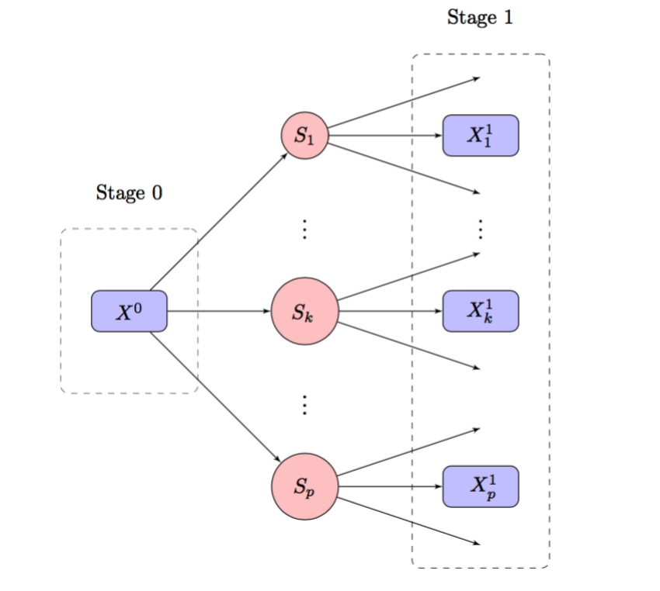
Two-stage decision-making process with p scenarios
Stage 0: An initial decision is made before any scenario revelation (Scenario free decision).
Stage 1: A Contingent/recourse decision to be taken if the scenario k is revealed (Scenario dependent decision).
Shavazipour, B. and Stewart, T.J., 2021. Multi-objective optimisation under deep uncertainty. Operational Research, 21, 2459–2487. https://doi.org/10.1007/s12351-019-00512-1.

Slide 15
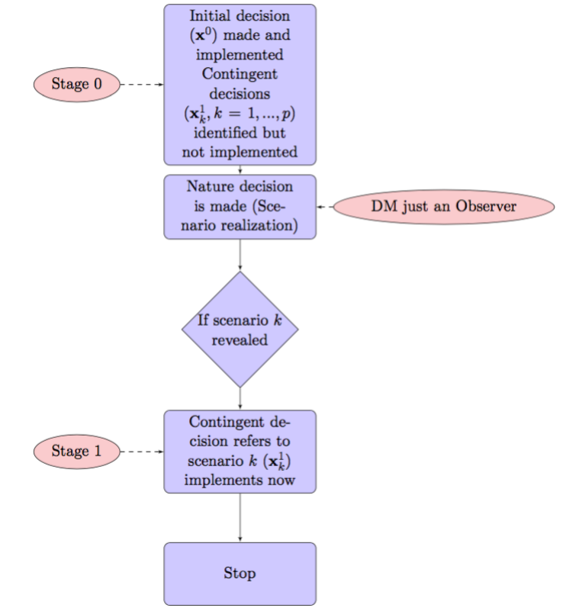
The schematic of two-stage
decision-making process
Models are not used to produce forecasts
Identify the reasonable initial decision (which is compensable, whatever happens in the future) + suitable contingent scenario-dependent decision(s) for every single plausible scenario, implemented after scenario revelation.
Suitable to be used in prescriptive analytics

Slide 16
➢ We are looking one step ahead, postpone part of the decision and leave room for possible adaptation later (after scenario realisation).
➢ We identiﬁed suitable adaptive plans for every plausible scenario in advance.
➢ A robust decision in our philosophy (dynamic-robust decision) is a split decision containing two subgroups of decisions:
The initial decision(s) followed by recourse decision(s)
➢ Unlike the regular robust solution, the initial decision does not need to be optimal or even feasible under conditions of all scenarios. Instead, it must be good enough, with beneﬁcial foresight, to lead us to the optimal aggregations of this initial decision(s) and the following recourse decisions.

Slide 17
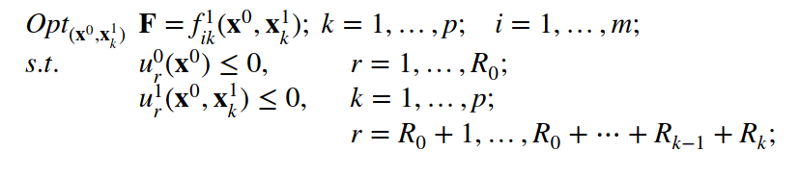
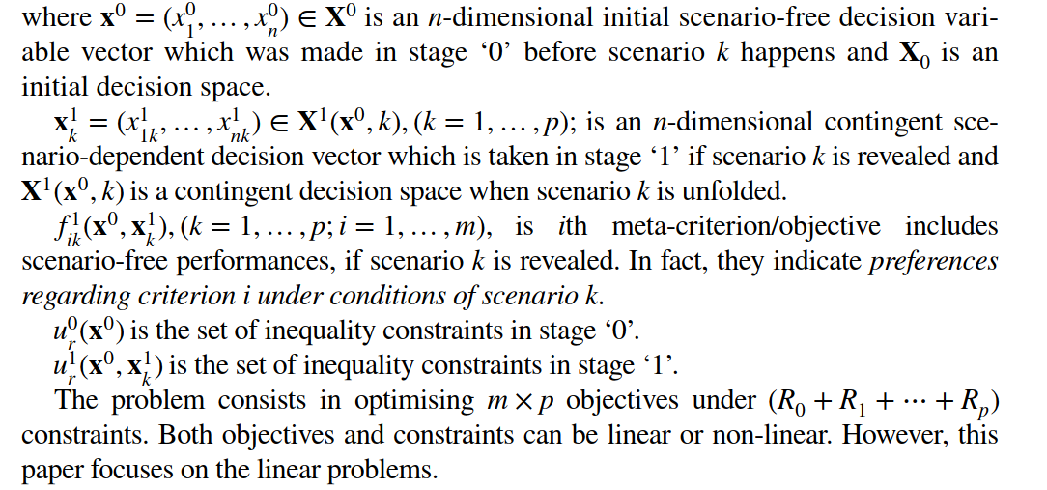
Mathematical Formulation
Shavazipour, B. and Stewart, T.J., 2021. Multi-objective optimisation under deep uncertainty. Operational Research, 21, 2459–2487.

Slide 18
Some advantages of the two-stage framework
➢ Make a reasonable decision at the ﬁrst stage(under uncertainty), followed by a subsequent decision stage after scenario realization.
➢ Ability to treat the higher degrees of uncertainty specially when there is not enough information about the probability space and distributions.
➢ An opportunity for DM to make a plan for subsequent decisions while the consequences of the initial decision after the realization of each and every plausible scenario are considered.
➢ Provides feasible solutions in the conditions that previous models failed (empty intersection between the scenarios).
➢ Provide a less risk-averse solution and in the meantime provides the same, or even better, robustness compares to typical robust approaches(Dynamic-Robust).
➢ Can be extended to multi-stages (>2)

Slide 19
Example. SBMOO for quarantine during the pandemics: The case study of COVID-19
This crisis should be a wake-up call to address long-term vulnerabilities (deep uncertainty).
Objective functions:
Min Economic crises (unemployment salary, bankruptcy (e.g. 2500 £ per person in UK)
Min Social crises (unemployment, individual stress)
Min the length of quarantine
Min The number of deaths
Min the number of infected
Scenarios:
The best-case e.g. the virus mutates and actually dies out
The weather may help (warmness in summer may decrease the speed of spread).
Enjoy a summer break before a second wave in the fall.
Effective antiviral medicine is found
The worst-case scenario, almost all people are infected and a lot of them are died

Slide 20
Example (cont.). SBMOO for quarantine during the pandemics: The case study of COVID-19
Decision variables:
Initial (e.g., (not) lockdown a city; quarantine the returnees; monitor persons with positive corona test)
Recourse (e.g., when (close) open the entries)
Constraints:
Surge critical care bed capacity
Limitations in lockdown
Sources:
https://www.weforum.org/agenda/2020/03/why-lockdowns-work-epidemics-coronavirus-covid19/
https://www.nytimes.com/2020/03/20/opinion/sunday/coronavirus-outcomes.html
Dr Tara C. Smith, an epidemiologist at Kent State University, said: “I’m not pessimistic. I think this can work.” She thinks it will take eight weeks of social distancing to have a chance to slow the virus, and success will depend on people changing behaviors and on hospitals not being overrun.
In the worst-case scenario, will social services collapse in some areas? Will order fray? Gun sales are increasing because some people expect chaos and crime.

Slide 21
Conclusions
Uncertainty is always present in decision making
In reality, we are surrounded by higher degrees of uncertainty
Ignoring uncertainty is a terrible idea
We cannot predict the future, but we can be prepared for Black Swans
Dynamic robust and adaptive decisions are good ways of dealing with deep uncertainty
Get implementation under way
Allow adaptations of decision over time as new information arrived, new solutions are developed, values change, and other external events take place
Enable learning from experience over time

Slide 22


Take-home message:
“There are things that we know that we know;
there are things that we know that we don’t know;
there are things that we don’t know that we don’t know.”
– Donald Rumsfeld
To make a robust, adaptive decision we need to consider the things that we know that we don’t know and preparing for the things that we don’t know that we don’t know.
Be prepared for the future to save the world!

Slide 23
Thank you

